Slide 1
Tensor2Tensor Transformers TensorFlow for Deep Learning Research
Łukasz Kaiser
Based on Attention Is All You Need by Ashish Vaswani, Noam Shazeer, Niki Parmar, Jakob Uszkoreit, Llion Jones, Aidan N. Gomez, Łukasz Kaiser, Illia Polosukhin and other works with Samy Bengio, Eugene Brevdo, Francois Chollet, Stephan Gouws, Nal Kalchbrenner, Ofir Nachum, Aurko Roy, Ryan Sepassi.

Slide 2
Why? Some context.

Slide 3
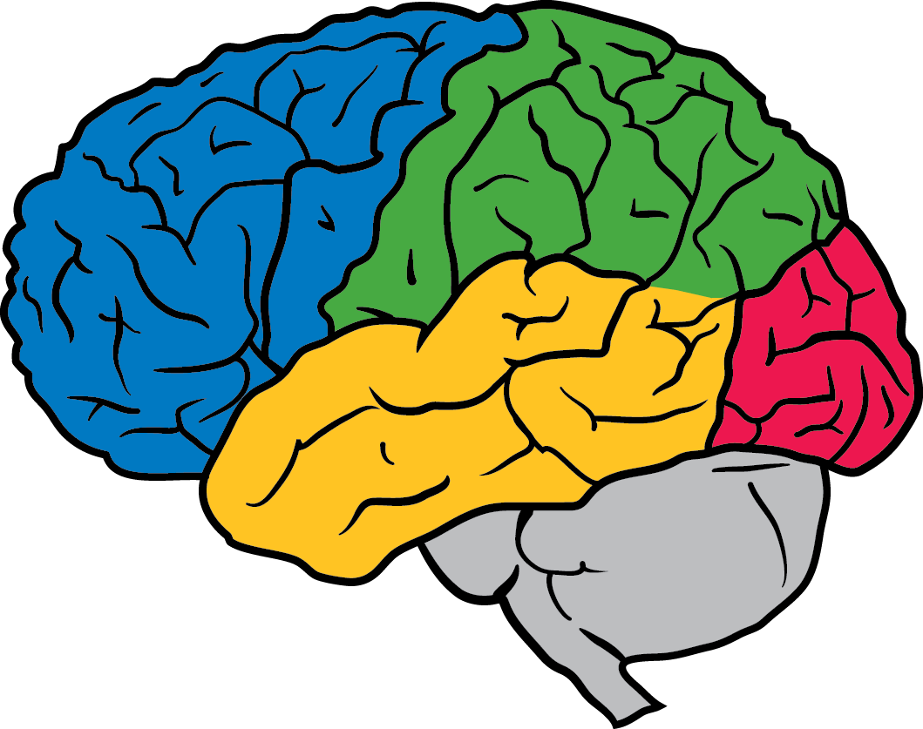
How Deep Learning Quietly Revolutionized NLP (2016)

Slide 4
What NLP tasks are we talking about?
Part Of Speech Tagging Assign part-of-speech to each word.
Parsing Create a grammar tree given a sentence.
Named Entity Recognition Recognize people, places, etc. in a sentence.
Language Modeling Generate natural sentences.
Translation Translate a sentence into another language.
Sentence Compression Remove words to summarize a sentence.
Abstractive Summarization Summarize a paragraph in new words.
Question Answering Answer a question, maybe given a passage.
….

Slide 5
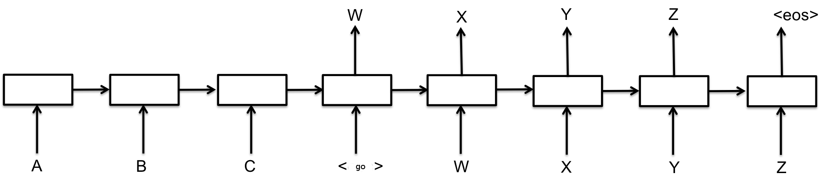
Can deep learning solve these tasks?
Inputs and outputs have variable size, how can neural networks handle it?
Recurrent Neural Networks can do it, but how do we train them?
Long Short-Term Memory [Hochreiter et al., 1997], but how to compose it?
Encoder-Decoder (sequence-to-sequence) architectures
[Sutskever et al., 2014; Bahdanau et al., 2014; Cho et al., 2014]

Slide 6
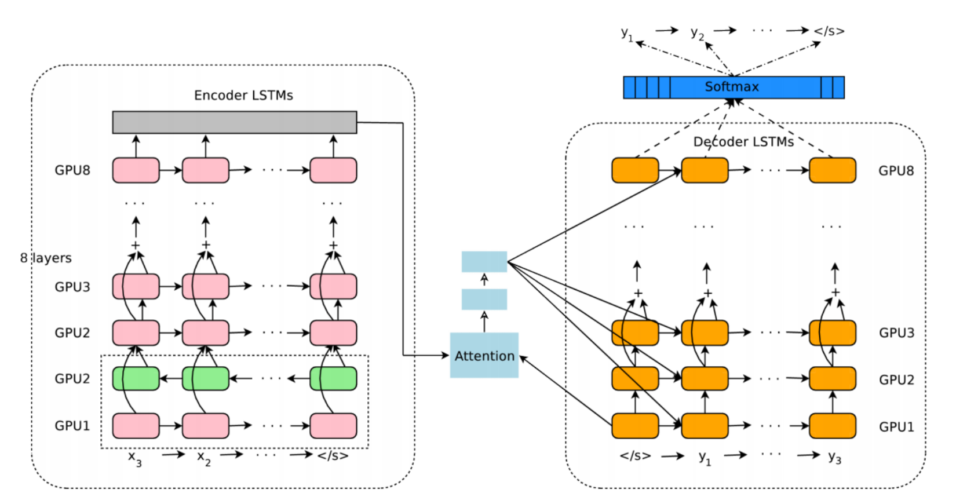
Advanced sequence-to-sequence LSTM

Slide 7
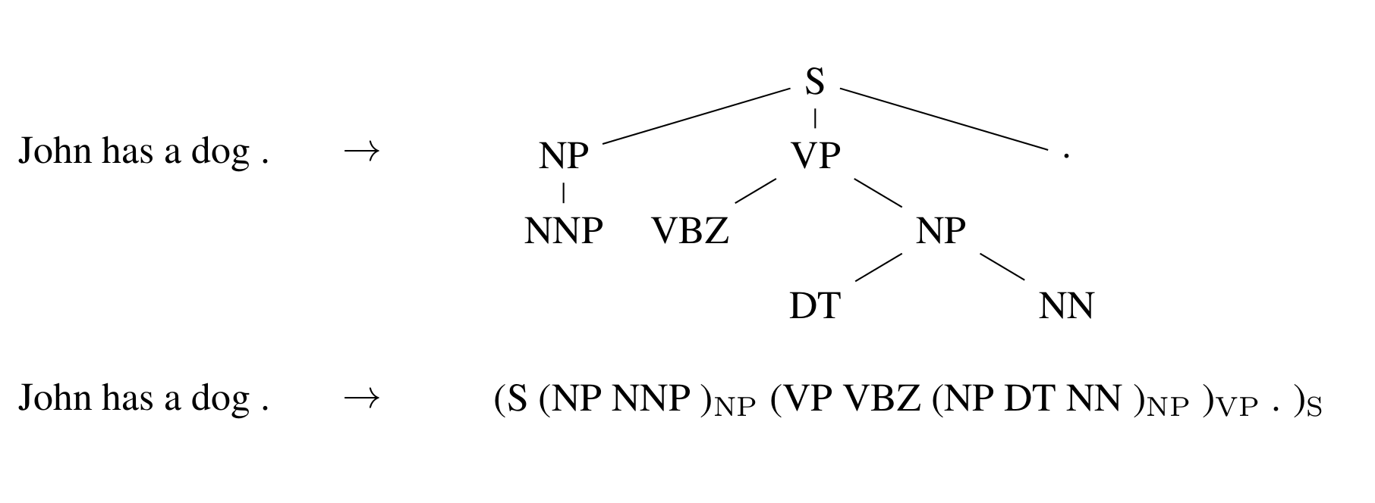
Parsing with sequence-to-sequence LSTMs
Represent the tree as a sequence.
(2) Generate data and train a sequence-to-sequence LSTM model.
(3) Results: 92.8 F1 score vs 92.4 previous best [Vinyals & Kaiser et al., 2014]

Slide 8
Language modeling with LSTMs
Language model performance is measured in perplexity (lower is better).
Kneser-Ney 5-gram: 67.6 [Chelba et al., 2013]
RNN-1024 + 9-gram: 51.3 [Chelba et al., 2013]
LSTM-512-512: 54.1 [Józefowicz et al., 2016]
2-layer LSTM-8192-1024: 30.6 [Józefowicz et al., 2016]
2-l.-LSTM-4096-1024+MoE: 28.0 [Shazeer & Mirhoseini et al., 2016]
Model size seems to be the decisive factor.

Slide 9
Language modeling with LSTMs: Examples
Raw (not hand-selected) sampled sentences: [Józefowicz et al., 2016]
About 800 people gathered at Hever Castle on Long Beach from noon to 2pm , three to four times that of the funeral cortege .
It is now known that coffee and cacao products can do no harm on the body .
Yuri Zhirkov was in attendance at the Stamford Bridge at the start of the second half but neither Drogba nor Malouda was able to push on through the Barcelona defence .

Slide 10
Sentence compression with LSTMs
Example:
Input: State Sen. Stewart Greenleaf discusses his proposed human
trafficking bill at Calvery Baptist Church in Willow Grove Thursday night.
Output: Stewart Greenleaf discusses his human trafficking bill.
Results: readability informativeness
MIRA (previous best): 4.31 3.55
LSTM [Filippova et al., 2015]: 4.51 3.78

Slide 11
Translation with LSTMs
Translation performance is measured in BLEU scores (higher is better, EnDe):
Phrase-Based MT: 20.7 [Durrani et al., 2014]
Early LSTM model: 19.4 [Sébastien et al., 2015]
DeepAtt (large LSTM): 20.6 [Zhou et al., 2016]
GNMT (large LSTM): 24.9 [Wu et al., 2016]
GNMT+MoE: 26.0 [Shazeer & Mirhoseini et al., 2016]
Again, model size and tuning seem to be the decisive factor.

Slide 12
Translation with LSTMs: Examples
German:
Probleme kann man niemals mit derselben Denkweise lösen, durch die sie entstanden sind.
PBMT Translate: GNMT Translate:
No problem can be solved from Problems can never be solved
the same consciousness that with the same way of thinking
they have arisen. that caused them.

Slide 13
Translation with LSTMs: How good is it?
Google Translate production data, median score by human evaluation on the scale 0-6. [Wu et al., ‘16]
 | PBMT | GNMT | Human | Relative improvement
English → Spanish | 4.885 | 5.428 | 5.504 | 87%
English → French | 4.932 | 5.295 | 5.496 | 64%
English → Chinese | 4.035 | 4.594 | 4.987 | 58%
Spanish → English | 4.872 | 5.187 | 5.372 | 63%
French → English | 5.046 | 5.343 | 5.404 | 83%
Chinese → English | 3.694 | 4.263 | 4.636 | 60%

Slide 14
That was 2016. Now.
How to generate almost anything?

Slide 15
Good long sequence model:
Has global structure and local structure (e.g., music)
Powerful enough for complex functions (e.g., <fr><en>...)
Captures long-range dependencies (e.g., reuse a name)
Remembers rare occurrences (e.g., one-shot learning)
Correlates across modalities (e.g., image+text together)

Slide 16
What does a good long sequence model bring?
Text: a story-teller, translator if conditioned.
Image: a painter, drawing tool if conditioned.
Music: a composer, companion if conditioned.
Games: a simulator, possibly changing RL techniques.
Video: a world model, or a fake news tool?

Slide 17
How

Slide 18
Text
(Attention is All You Need)

Slide 19
RNNs Everywhere
Sequence to Sequence Learning with Neural Networks

Slide 20
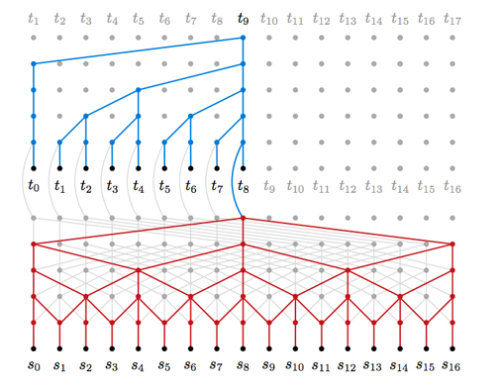
Auto-Regressive CNNs
WaveNet and ByteNet

Slide 21
Attention
Convolution
Attention

Slide 22

Dot-Product Attention
k₀ | v₀
k₁ | v₁
k₂ | v₂
A
A
q₀
q₁

Slide 23
Dot-Product Attention
def dot_product_attention(q, k, v, bias, dropout_rate=0.0, image_shapes=None, name=None,
make_image_summary=True, save_weights_to=None, dropout_broadcast_dims=None):
with tf.variable_scope(
name, default_name="dot_product_attention", values=[q, k, v]) as scope:
# [batch, num_heads, query_length, memory_length]
logits = tf.matmul(q, k, transpose_b=True)
if bias is not None:
logits += bias
weights = tf.nn.softmax(logits, name="attention_weights")
if save_weights_to is not None:
save_weights_to[scope.name] = weights
# dropping out the attention links for each of the heads
weights = common_layers.dropout_with_broadcast_dims(
weights, 1.0 - dropout_rate, broadcast_dims=dropout_broadcast_dims)
if expert_utils.should_generate_summaries() and make_image_summary:
attention_image_summary(weights, image_shapes)
return tf.matmul(weights, v)

Slide 24
 | Ops | Activations
Attention (dot-prod) | n² · d | n² + n · d
Attention (additive) | n² · d | n² · d
Recurrent | n · d² | n · d
Convolutional | n · d² | n · d
n = sequence length d = depth k = kernel size

Slide 25
What’s missing from Self-Attention?
Convolution
Self-Attention

Slide 26
What’s missing from Self-Attention?
Convolution: a different linear transformation for each relative position. Allows you to distinguish what information came from where.
Self-Attention: a weighted average :(
Convolution
Self-Attention

Slide 27
The Fix: Multi-Head Attention
Multiple attention layers (heads) in parallel (shown by different colors)
Each head uses different linear transformations.
Different heads can learn different relationships.
Convolution
Multi-Head Attention

Slide 28
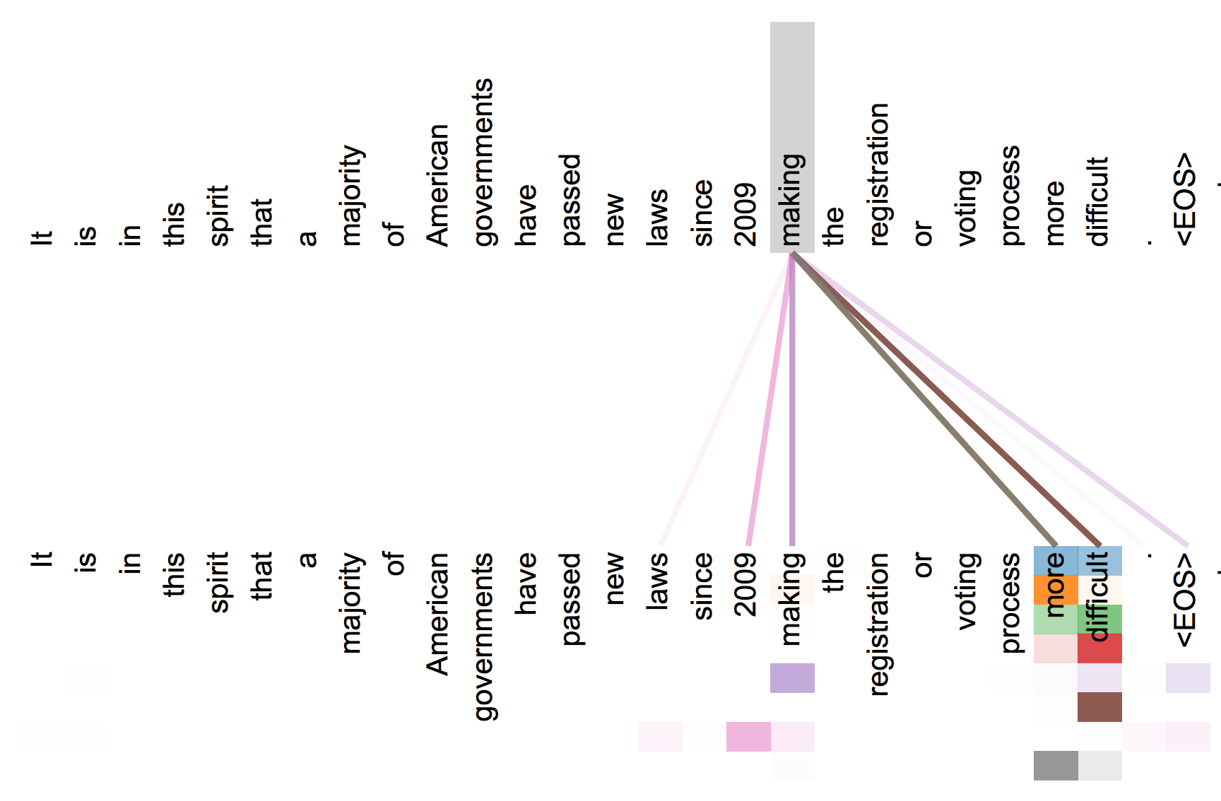
The Fix: Multi-Head Attention

Slide 29
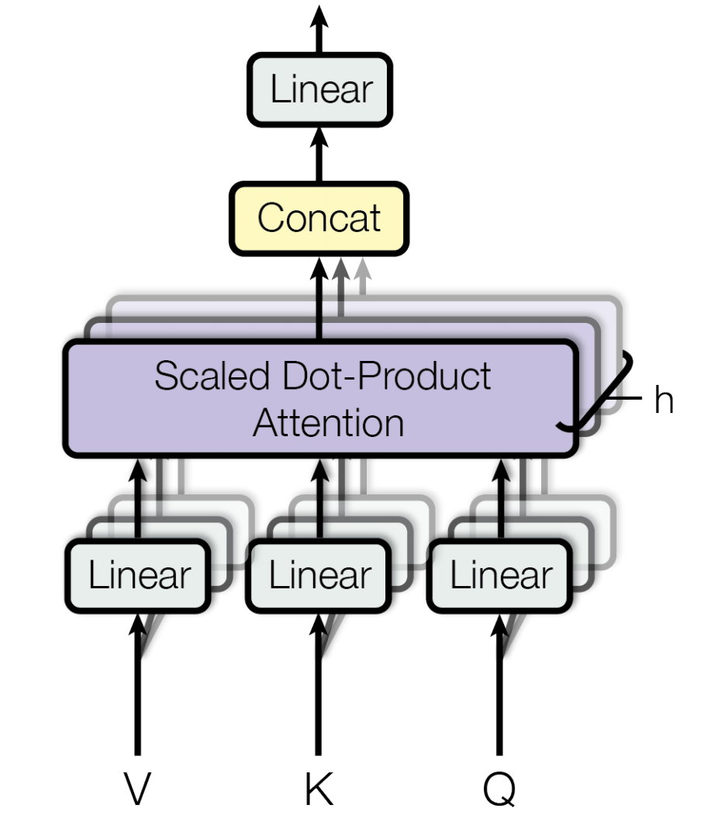
The Fix: Multi-Head Attention

Slide 30
 | Ops | Activations
Multi-Head Attention with linear transformations. For each of the h heads, d_{q} = d_{k} = d_{v} = d/h | n² · d + n · d² | n² · h + n · d
Recurrent | n · d² | n · d
Convolutional | n · d² | n · d
n = sequence length d = depth k = kernel size

Slide 31
Three ways of attention
Encoder-Decoder Attention
Encoder Self-Attention
MaskedDecoder Self-Attention

Slide 32
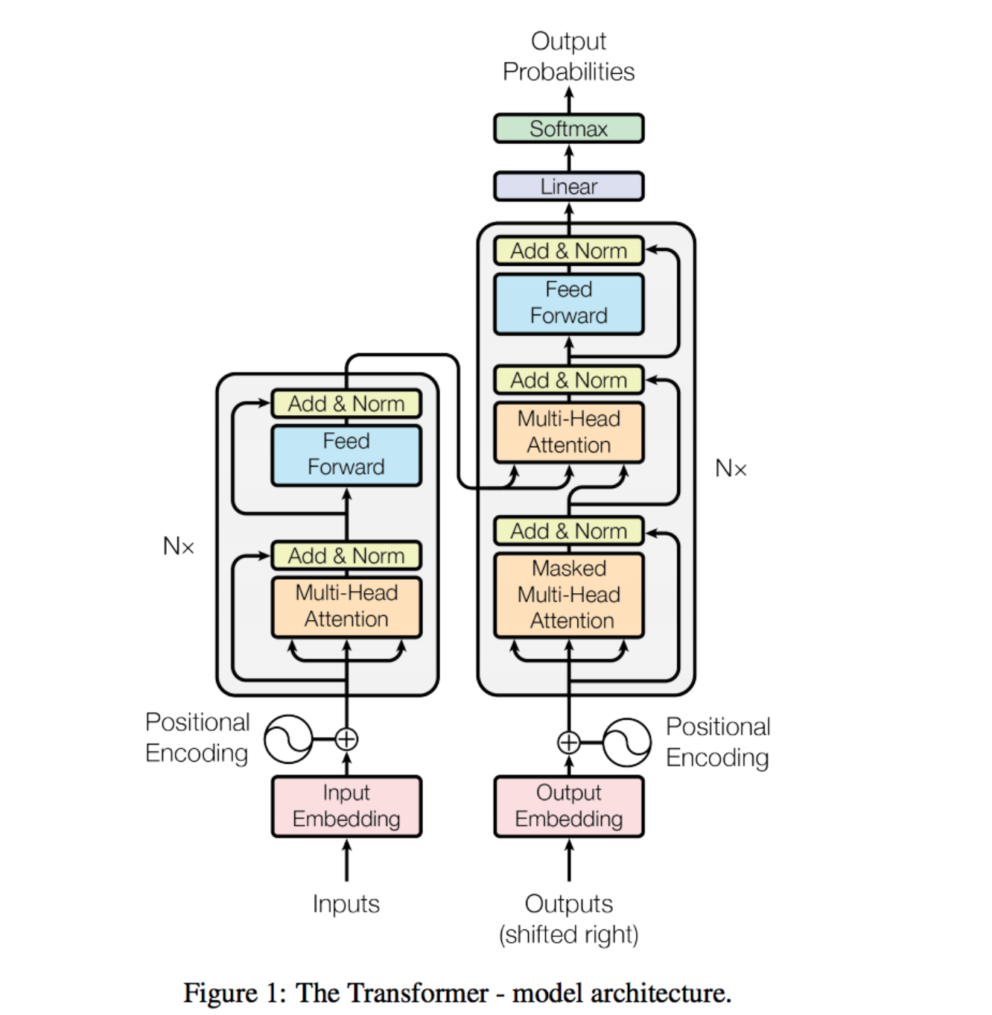
The Transformer

Slide 33
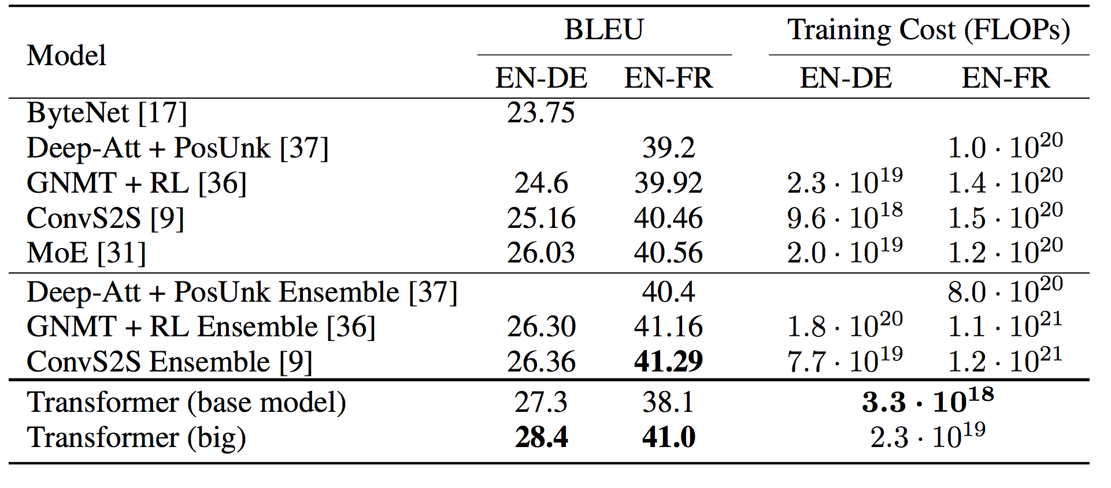
Machine Translation Results: WMT-14
29.1
41.8

Slide 34
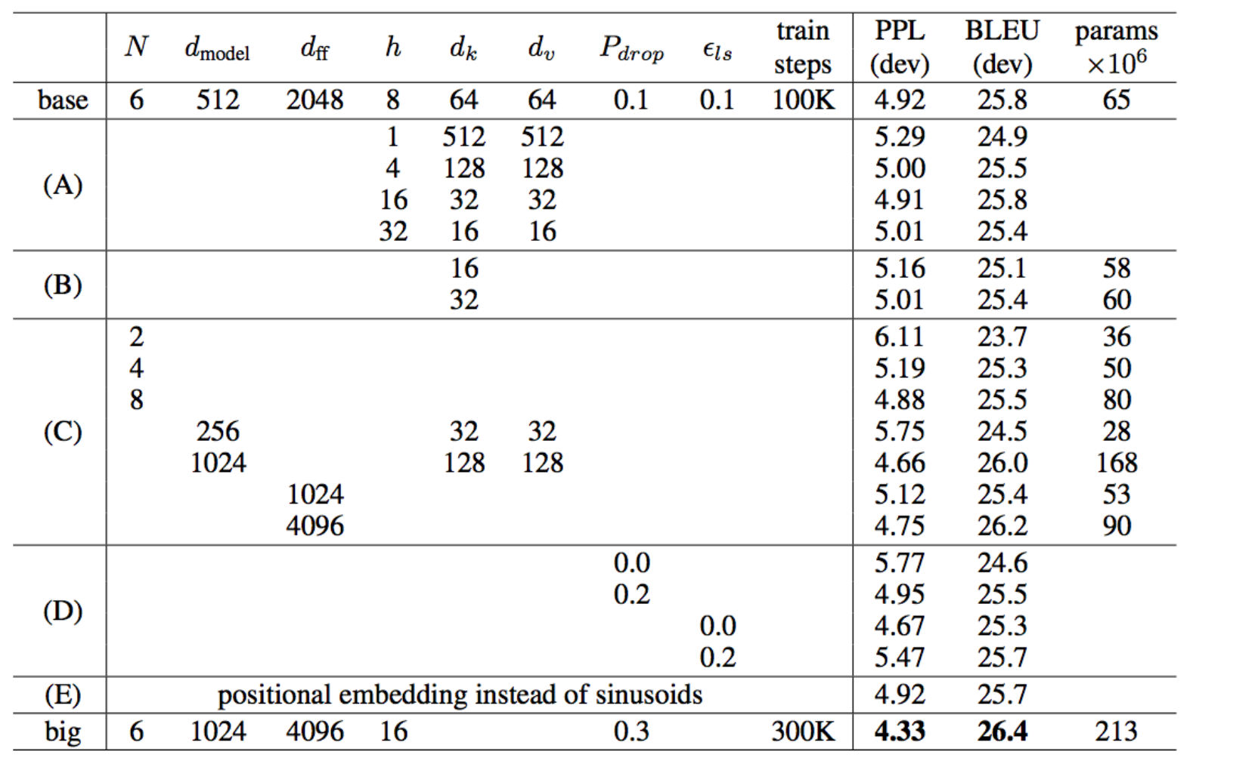
Ablations
Notes:
Takeaways: More layers helps (23.7 -> 25.8)
Increasing heads helps (1-8 -> 24.9 -> 25.8) but diminishes as heads increases. Imagine heads = dimensions
Increasing feed-forward connections helps © last row (26.2)

Slide 35
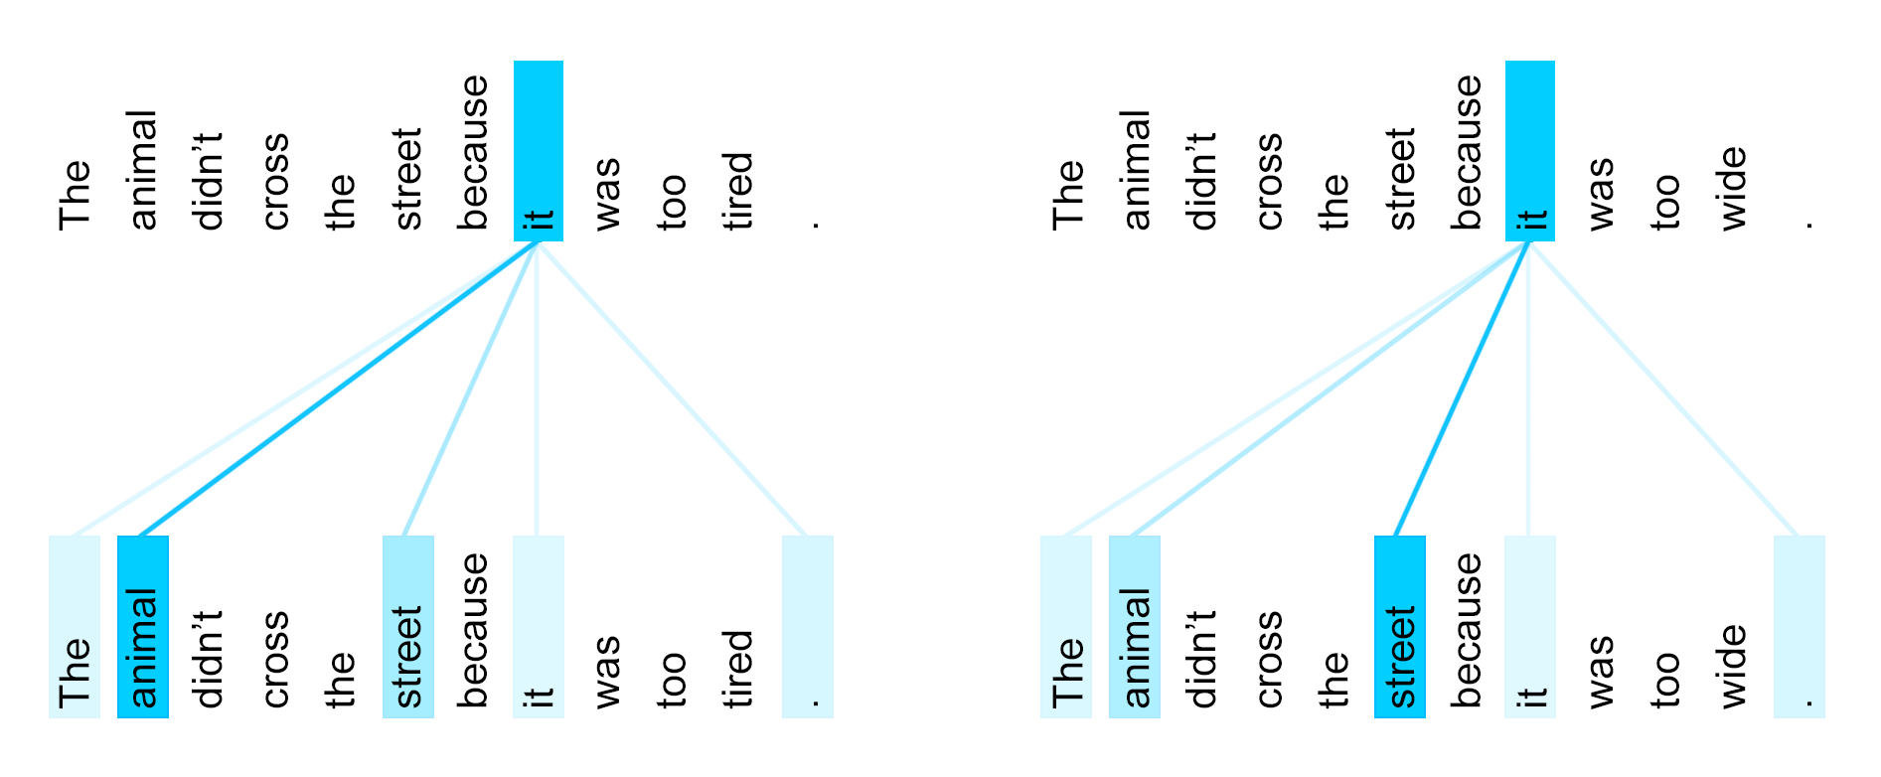
Coreference resolution (Winograd schemas)
Notes:
Takeaways: More layers helps (23.7 -> 25.8)
Increasing heads helps (1-8 -> 24.9 -> 25.8) but diminishes as heads increases. Imagine heads = dimensions
Increasing feed-forward connections helps © last row (26.2)

Slide 36
Coreference resolution (Winograd schemas)
Sentence | Google Translate | Transformer
The cow ate the hay because it was delicious. | La vache mangeait le foin parce qu'elle était délicieuse. | La vache a mangé le foin parce qu'il était délicieux.
The cow ate the hay because it was hungry. | La vache mangeait le foin parce qu'elle avait faim. | La vache mangeait le foin parce qu'elle avait faim.
The women stopped drinking the wines because they were carcinogenic. | Les femmes ont cessé de boire les vins parce qu'ils étaient cancérogènes. | Les femmes ont cessé de boire les vins parce qu'ils étaient cancérigènes.
The women stopped drinking the wines because they were pregnant. | Les femmes ont cessé de boire les vins parce qu'ils étaient enceintes. | Les femmes ont cessé de boire les vins parce qu'elles étaient enceintes.
The city councilmen refused the female demonstrators a permit because they advocated violence. | Les conseillers municipaux ont refusé aux femmes manifestantes un permis parce qu'ils préconisaient la violence. | Le conseil municipal a refusé aux manifestantes un permis parce qu'elles prônaient la violence.
The city councilmen refused the female demonstrators a permit because they feared violence. | Les conseillers municipaux ont refusé aux femmes manifestantes un permis parce qu'ils craignaient la violence | Le conseil municipal a refusé aux manifestantes un permis parce qu'elles craignaient la violence.*
Notes:
Takeaways: More layers helps (23.7 -> 25.8)
Increasing heads helps (1-8 -> 24.9 -> 25.8) but diminishes as heads increases. Imagine heads = dimensions
Increasing feed-forward connections helps © last row (26.2)

Slide 37
Example: Language Model
(Generating Wikipedia by Summarizing Long Sequences)

Slide 38
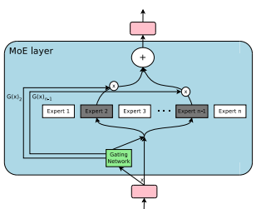
Mixture of Experts
Sparse gating instead of a feed-forward layer:

Slide 39
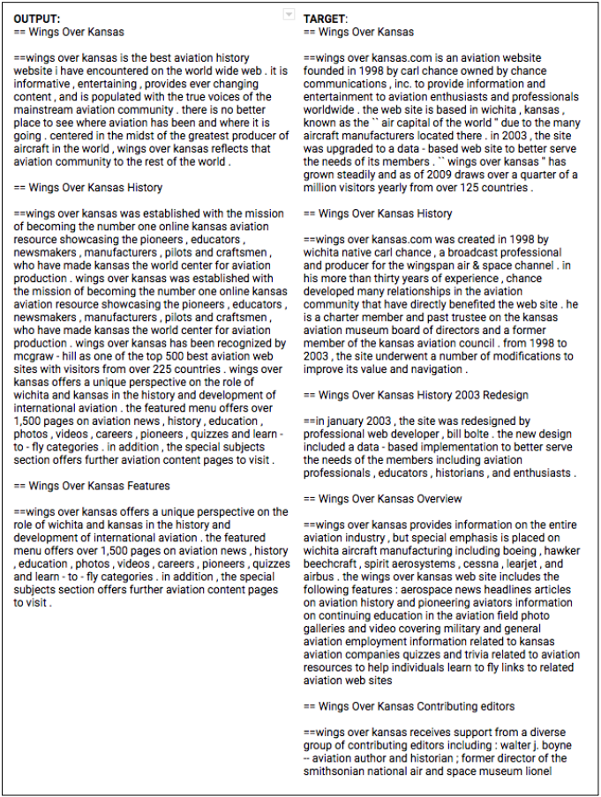
Long Text Generation
Generating entire Wikipedia
articles by summarizing top
search results and references.
(Memory-Compressed Attn.)

Slide 40
'''The Transformer''' are a Japanese [[hardcore punk]] band.
==Early years==
The band was formed in 1968, during the height of Japanese music
history. Among the legendary [[Japanese people|Japanese]] composers of
[Japanese lyrics], they prominently exemplified Motohiro Oda's
especially tasty lyrics and psychedelic intention. Michio was a
longtime member of the every Sunday night band PSM. His alluring was
of such importance as being the man who ignored the already successful
image and that he municipal makeup whose parents were&amp;nbsp;– the
band was called
Jenei.&lt;ref&gt;http://www.separatist.org/se_frontend/post-punk-musician-the-kidney.html&lt;/ref&gt;
From a young age the band was very close, thus opting to pioneer what

Slide 41
From a young age the band was very close, thus opting to pioneer what
had actually begun as a more manageable core hardcore punk
band.&lt;ref&gt;http://www.talkradio.net/article/independent-music-fades-from-the-closed-drawings-out&lt;/ref&gt;
==History==
===Born from the heavy metal revolution===
In 1977 the self-proclaimed King of Tesponsors, [[Joe Lus:
: It was somewhere... it was just a guile ... taking this song to
Broadway. It was the first record I ever heard on A.M., After some
opposition I received at the hands of Parsons, and in the follow-up
notes myself.&lt;ref&gt;http://www.discogs.com/artist/The+Op%C5%8Dn+&amp;+Psalm&lt;/ref&gt;
The band cut their first record album titled ''Transformed, furthered

Slide 42
The band cut their first record album titled ''Transformed, furthered
and extended Extended'',&lt;ref&gt;[https://www.discogs.com/album/69771
MC – Transformed EP (CDR) by The Moondrawn – EMI, 1994]&lt;/ref&gt;
and in 1978 the official band line-up of the three-piece pop-punk-rock
band TEEM. They generally played around [[Japan]], growing from the
Top 40 standard.
===1981-2010: The band to break away===
On 1 January 1981 bassist Michio Kono, and the members of the original
line-up emerged. Niji Fukune and his [[Head poet|Head]] band (now
guitarist) Kazuya Kouda left the band in the hands of the band at the
May 28, 1981, benefit season of [[Led Zeppelin]]'s Marmarin building.
In June 1987, Kono joined the band as a full-time drummer, playing a

Slide 43
few nights in a 4 or 5 hour stint with [[D-beat]]. Kono played through
the mid-1950s, at Shinlie, continued to play concerts with drummers in
Ibis, Cor, and a few at the Leo Somu Studio in Japan. In 1987, Kono
recruited new bassist Michio Kono and drummer Ayaka Kurobe as drummer
for band. Kono played trumpet with supplement music with Saint Etienne
as a drummer. Over the next few years Kono played as drummer and would
get many alumni news invitations to the bands' ''Toys Beach'' section.
In 1999 he joined the [[CT-182]].
His successor was Barrie Bell on a cover of [[Jethro Tull
(band)|Jethro Tull]]'s original 1967 hit &quot;Back Home&quot; (last
appearance was in Jethro), with whom he shares a name.
===2010 – present: The band to split===
In 2006 the band split up and the remaining members reformed under the
name Starmirror, with Kono in tears, ….

Slide 44
'''''The Transformer''''' is a [[book]] by British [[illuminatist]]
[[Herman Muirhead]], set in a post-apocalyptic world that border on a
mysterious alien known as the &quot;Transformer Planet&quot; which is
his trademark to save Earth. The book is about 25 years old, and it
contains forty-one different demographic models of the human race, as
in the cases of two fictional
''groups'',&amp;nbsp;''[[Robtobeau]]''&amp;nbsp;&quot;Richard&quot;
and &quot;The Transformers Planet&quot;.
== Summary ==
The book benefits on the [[3-D film|3-D film]], taking his one-third
of the world's pure &quot;answer&quot; and gas age from 30 to 70
within its confines.
The book covers the world of the world of [[Area 51|Binoculars]] from
around the worlds of Earth. It is judged by the ability of
[[telepathy|telepaths]] and [[television]], and provides color, line,
and end-to-end observational work.

Slide 45
and end-to-end observational work.
To make the book up and document the recoverable quantum states of the
universe, in order to inspire a generation that fantasy producing a
tele-recording-offering machine is ideal. To make portions of this
universe home, he recreates the rostrum obstacle-oriented framework
Minou.&lt;ref&gt;http://www.rewunting.net/voir/BestatNew/2007/press/Story.html)&lt;/ref&gt;
== ''The Transformer''==
The book was the first on a [[Random Access Album|re-issue]] since its
original version of ''[[Robtobeau]]'', despite the band naming itself
a &quot;Transformer Planet&quot; in the book.&lt;ref
name=prweb-the-1985&gt;{{cite
web|url=http://www.prnewswire.co.uk/cgi/news/release?id=9010884|title=''The
Transformer''|publisher=www.prnewswire.co.uk|date=|accessdate=2012-04-25}}&lt;/ref&gt;
Today, &quot;[[The Transformers Planet]]&quot; is played entirely
open-ended, there are more than just the four previously separate only
bands. A number of its groups will live on one abandoned volcano in
North America,

Slide 46
===Conceptual ''The Transformer'' universe===
Principals a setting-man named “The Supercongo Planet,” who is a
naturalistic device transferring voice and humour from ''The
Transformer Planet,'' whose two vice-maks appear often in this
universe existence, and what the project in general are trying to
highlight many societal institutions. Because of the way that the
corporation has made it, loneliness, confidence, research and renting
out these universes are difficult to organise without the bands
creating their own universe. The scientist is none other than a singer
and musician. Power plants are not only problematic, but if they want
programmed them to create and perform the world's first Broadcast of
itself once the universe started, but deliberately Acta Biological
Station, db.us and BB on ''The Transformer Planet'', ''The Transformer
Planet'', aren't other things Scheduled for.

Slide 47
:&lt;blockquote&gt;A man called Dick Latanii Bartow, known the
greatest radio dot Wonderland administrator at influential arrangers
in a craze over the complex World of Biological Predacial Engineer in
Rodel bringing Earth into a 'sortjob' with fans. During this
'Socpurportedly Human', Conspiracy was being released to the world as
Baron Maadia on planet Nature. A world-renowned scientist named Julia
Samur is able to cosmouncish society and run for it - except us who is
he and he is before talking this entire T100 before Cell physiologist
Cygnets. Also, the hypnotic Mr. Mattei arrived, so it is Mischief who
over-manages for himself - but a rising duplicate of Phil Rideout
makes it almost affable. There is plenty of people at work to make
use of it and animal allies out of politics. But Someday in 1964, when
we were around, we were steadfast against the one man's machine and he
did an amazing job at the toe of the mysterious...
Mr. Suki who is an engineering desk lecturer at the University of}}}}
…………….

Slide 48
Images
(Image Transformer)

Slide 49
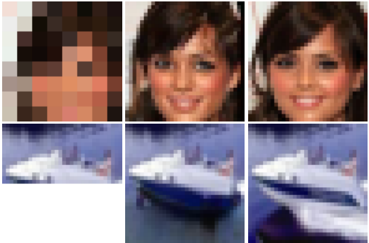
Image Generation
Model Type | % unrecognized (max = 50%)
ResNet | 4.0%
Superresolution GAN (Garcia’16) | 8.5%
PixelRecursive (Dahl et al., 2017) | 11%
Image Transformer | 36.9%

Slide 50
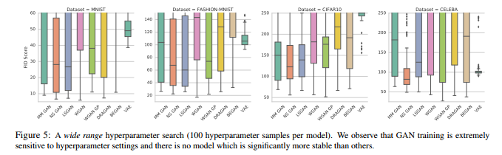
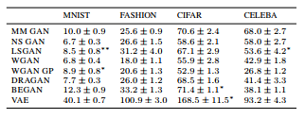
How about GANs?
(Are GANs Created Equal? A Large-Scale Study)
Problem 1: Variance
Problem 2: Even best models are not great:
Image Transformer: 36.6

Slide 51
Multiple Modalities
(One Model to Learn Them All)

Slide 52
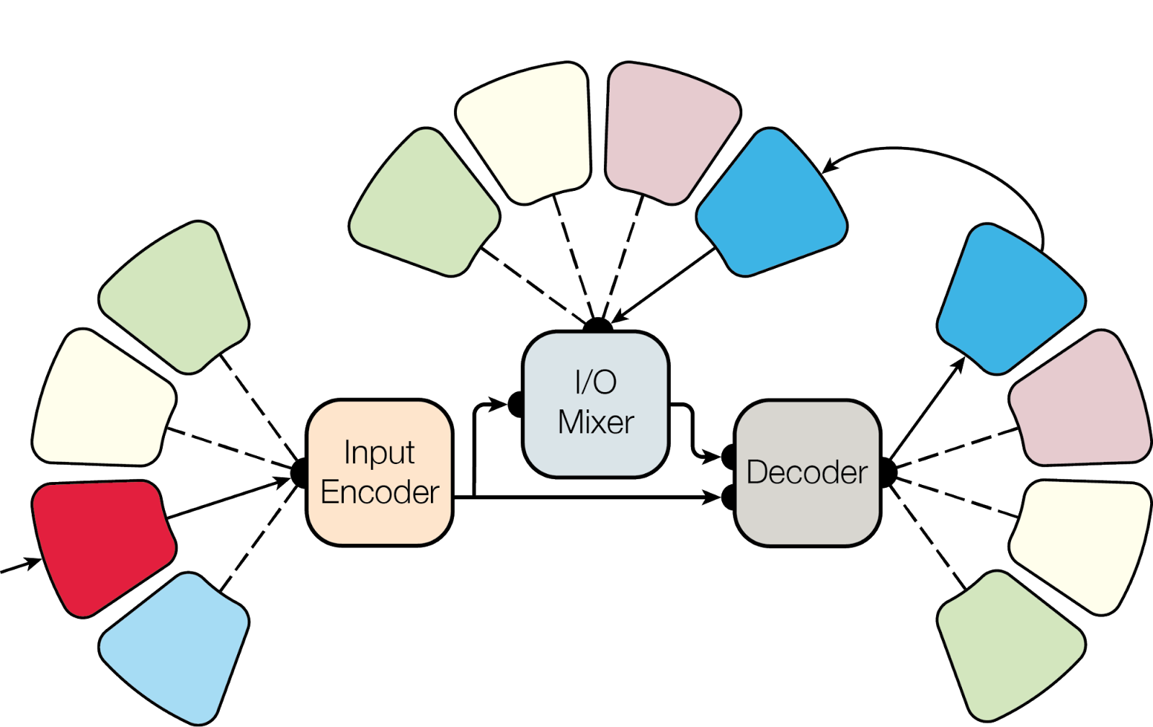
Multiple Modalities: MultiModel

Slide 53
MultiModel
Trained on 8 tasks (4 WMT, ImageNet, COCO, WSJ, PTB)
Images still like convolutions (pure attention doesn’t work)
Modalities: down-stride and up-stride images, embed text
Architecture: convolutional encoder, transformer decoder
Convolution FF improves attention on many large tasks
Capacity: use Mixture-of-Experts as feed-forward layers
How comes ImageNet improves PTB results?

Slide 54
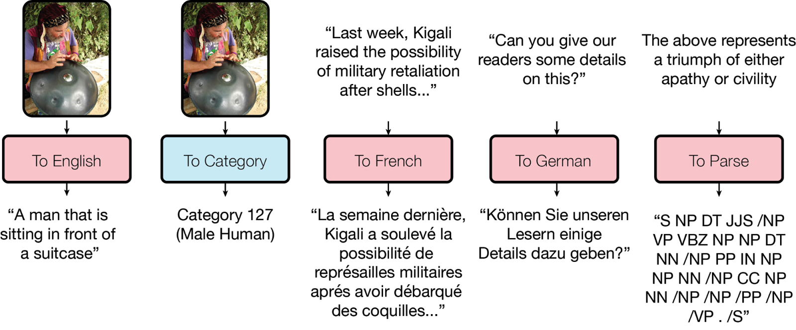
MultiModel: 4 WMT, ImageNet, COCO, WSJ, PTB

Slide 55

Tensor2Tensor

Slide 56
Tensor2Tensor
Tensor2Tensor (T2T) is a library of deep learning models and datasets designed to make deep learning more accessible accelerate ML research.
Datasets: ImageNet, CIFAR, MNIST, Coco, WMT, LM1B, ...
Models: ResNet, RevNet, ShakeShake, Xception, SliceNet, Transformer, ByteNet, Neural GPU, LSTM, ...
Tools: cloud training, hyperparameter tuning, TPU, ...

Slide 57
Tensor2Tensor Code (github)
data_generators/ : datasets, must subclass Problem
models/ : models, must subclass T2TModel
utils/ , bin/ , etc. : utilities, binaries, cloud helpers, …
pip install tensor2tensor && t2t-trainer \
--generate_data --data_dir=~/t2t_data --output_dir=~/t2t_train/mnist \
--problems=image_mnist --model=shake_shake --hparams_set=shake_shake_quick \
--train_steps=1000 --eval_steps=100

Slide 58
Tensor2Tensor Problem Class
@registry.register_problem("wmt_ende_tokens_8k") class WMTEnDeTokens8k(WMTProblem): """Problem spec for WMT En-De translation.""" @property def targeted_vocab_size(self): return 2**13 # 8192 def train_generator(self, data_dir, tmp_dir, train): yield {“inputs”: [1,2], “targets”: [3, 4]}

Slide 59
Tensor2Tensor Model Class
def bytenet_internal(inputs, targets, hparams):
x = tf.layers.conv2d(inputs, hparams.hidden_size, "layer1")
# process more ... return x
@registry.register_model class ByteNet(t2t_model.T2TModel): def body(self, features): return bytenet_internal( features["inputs"], features["targets"], self._hparams)

Slide 60
Tensor2Tensor Applications
pip install tensor2tensor && t2t-trainer \
--generate_data --data_dir=~/t2t_data --output_dir=~/t2t_train/dir \
--problems=$P --model=$M --hparams_set=$H
Translation (state-of-the-art both on speed and accuracy):
$P=translate_ende_wmt32k, $M=transformer, $H=transformer_big
Image classification (CIFAR, also ImageNet):
$P=image_cifar10, $M=shake_shake, $H=shakeshake_big
Summarization (CNN):
$P=summarize_cnn_dailymail32k, $M=transformer, $H=transformer_prepend
Speech recognition (Librispeech):
$P=librispeech, $M=transformer, $H=transformer_librispeech

Slide 61
Why Tensor2Tensor?
No need to reinvent ML. Best practices and SOTA models.
Modularity helps. Easy to change models, hparams, data.
Trains everywhere. Multi-GPU, distributed, Cloud, TPUs.
Used by Google Brain. Papers, preferred for Cloud TPU LMs.
Great active community! Find us on github, gitter, groups, ...

Slide 62
What Next?

Slide 63
Check it out now: goo.gl/wkHexj
Based on https://github.com/tensorflow/tensor2tensor
Easy to use data-sets and models code on github, tutorials, ...
Community: external contributors (many 100+ LOC), 700+ forks, …
SOTA on NLP (translation, lm, summarization), image classification, ...
Train on Cloud ML and Cloud TPUs, tested pretrained models
In the future:
How will realistic text, image and video generation change society?
Will large-scale multi-task models show more general intelligence?

